Slide 1
Arrays

Slide 2
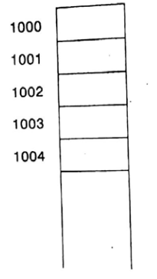
Linear Arrays
A linear array is a list of a finite number n of homogeneous data elements.
The elements of the array are referenced respectively by an index.
The elements of the array are stored respectively in successive memory locations.
Representation of Linear Arrays

Slide 3
Traversing a Linear Array
1. [Initialize counter] set K:=LB
2. Repeat step 3 & 4 while K<=UB.
3. [visit element] Apply process to LA[K].
4. [increase counter] set K=K+1.
5. Exit

Slide 4
(Inserting into a Linear Array) INSERT (LA, N, K, ITEM)
Here LA is a linear array with N elements and K is a positive integer such that K≤N. This algorithm inserts an element ITEM into the Kth position in LA.
[Initialize counter.] Set J: =N.
Repeat Steps 3 and 4 while J≥K.
[Move Jth element downward.] Set LA [J+1]:= LA [J].
[Decrease counter.]Set J: =J-1.
[End of Step 2 loop.]
5. [Insert element.] Set LA [K]: =ITEM.
6. [Reset N.]Set N: =N+1.
7. Exit.

Slide 5
(Deleting from a Linear Array) DELETE (LA, N, K, ITEM)
Here LA is a linear array with N elements and K is a positive integer such that K≤N. This algorithm deletes the Kth element from LA.
Set ITEM:=LA[K].
Repeat for J=K to N-1:
[Move J+1st element upward.] Set LA [J]:=LA [J+1].
[End of loop.]
3. [Reset the number N of elements in LA.] Set N:= N-1.
4. Exit.

Slide 6
Traversing, Insert and Delete
Index
0 | 1 | 2 | 3 | 4 | 5 | 6
55 | 68 | 40 | 89 | 43 | 98 | 48
Value

Slide 7
Multidimensional Arrays:
Two dimensional Arrays
(1,1) | (1,2) | (1,3)
(2,1) | (2,2) | (2,3)
(3,1) | (3,2) | (3,3)
Two dimensional Array (3x3)

Slide 8
Three dimensional Arrays:
(1,1) | (1,2) | (1,3)
(2,1) | (2,2) | (2,3)
(3,1) | (3,2) | (3,3)
(1,1) | (1,2) | (1,3)
(2,1) | (2,2) | (2,3)
(3,1) | (3,2) | (3,3)
(1,1) | (1,2) | (1,3)
(2,1) | (2,2) | (2,3)
(3,1) | (3,2) | (3,3)
3 Two dimensional Arrays (3x3x3)

Slide 9
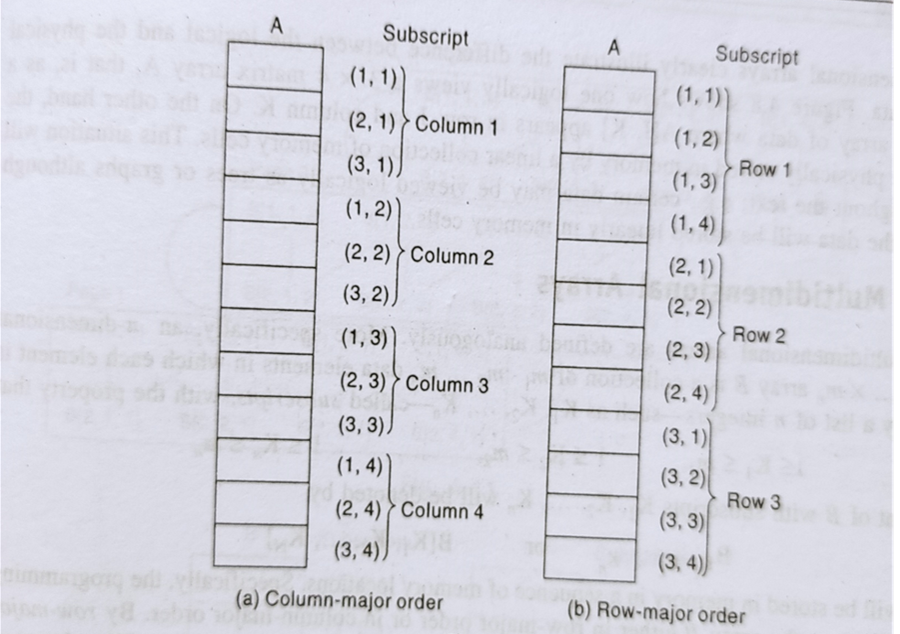
Representation of Two-Dimensional Arrays in Memory
Row major order
Column major order

Slide 10
Thank YOU

